Slide 1
Voter Turnout 2014
Karan Dassi

Slide 2
What is the problem?
Predict the voter turnout in 2014
Who is interested?
Why should this problem be solved?
To get results to have a clear understanding of what needs to be done
Prediction Model?
Logistic Regression
Our Campaign Team

Slide 3
Significant Factors
Significant Factors for Voter Turnout
Age of Voter
Ethnicity of Voter
Political Party
Congressional District
Designated Market Area
Most of the previous general election Turnouts
2008 and 2012 precinct turnouts
Pet Owner
Interest in Music

Slide 4
The prediction
The model found out that a total 15060 voters will most probably turn out to vote in 2014
That is a 30.12 percent out of a total voter population of 50,000
The prediction seem to be in line with previous years

Slide 5
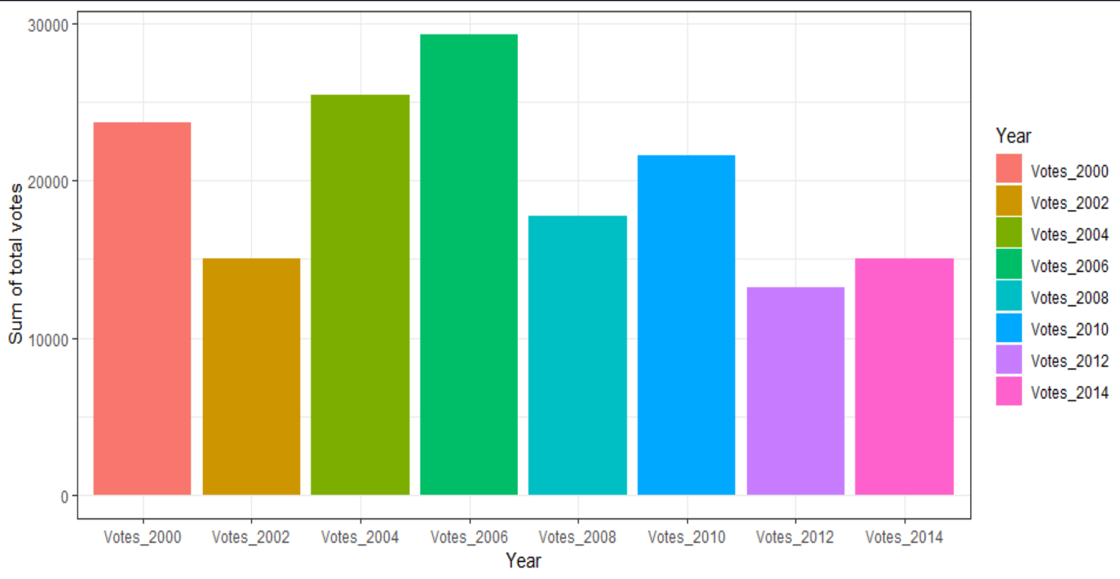
2014 voter prediction vs previous year numbers

